Slide 1
SHELL SORT
Sorting Algorithm

Slide 2
Shell sort is one of the sorting algorithms to sort the values.
It is founded by Donald Shell and named the sorting algorithm after himself in 1959.
Shell Sort is a comparison based sorting.
Shell sort works by comparing elements that are distant rather than adjacent elements in an array or list where adjacent elements are compared.
Shell sort makes multiple passes through a list and sorts a number of equally sized sets using the insertion sort
It improves on the efficiency of insertion sort by quickly shifting values to their destination.

Slide 3
This algorithm uses insertion sort on the large interval of elements to sort. Then the interval of sorting keeps on decreasing in a sequence until the interval reaches 1.
These intervals are known as gap sequence.
Increment Sequences:
Shell's original sequence: N/2 , N/4 , ..., 1 (repeatedly divide by 2).
Hibbard's increments: 1, 3, 7, ..., 2^{k} - 1 ; k = 1, 2, …
Knuth's increments: 1, 4, 13, ..., ( 3^{k} - 1) / 2 ; k = 1, 2, …
Sedgewick's increments: 1, 5, 19, 41, 109, .... k = 0, 1, 2,
Interleaving 9 (4^{k} – 2^{k}) + 1 and 2^{k+2} (2^{k+2} – 3 ) + 1.

Slide 4
Shell Sort Algorithm
Shell_Sort(Arr, n)
Step 1: SET FLAG = 1, GAP_SIZE = N
Step 2: Repeat Steps 3 to 6 while FLAG = 1 OR GAP_SIZE > 1
Step 3:SET FLAG = 0
Step 4:SET GAP_SIZE = (GAP_SIZE + 1) / 2
Step 5:Repeat Step 6 for I = 0 to I < (N -GAP_SIZE)
Step 6:IF Arr[I + GAP_SIZE] > Arr[I] SWAP Arr[I + GAP_SIZE], Arr[I] SET FLAG = 0
Step 7: END

Slide 5
Shell sort program
//Program of Shell Sort
import java.util.*;
class Shell {
void shellsort(int arr[], int n) {
int i, j, gap, tmp;
for (gap = n/2; gap>0; gap=gap/2) {
for (j = gap; j<n; j++) {
for(i = j - gap; k >= 0; i = i - gap)
{
if (arr[i]> arr[i+gap])
{
tmp = arr[i];
arr[i] = arr[i+gap];
arr[i+gap] = tmp;
}
}
}
}
} }
contd….

Slide 6
class Shellsort {
public static void main(String args[])
{
Scanner s=new Scanner(System.in);
int n;
System.out.println("Enter the size of the array");
n=s.nextInt();
int data[]=new int[n];
System.out.println("Enter the values into array");
for(int i=0;i<n;i++)
data[i]=s.nextInt();
System.out.println("Array before sorting");
for(int i=0;i<n;i++)
System.out.println(data[i]);
Shell ss = new Shell();
ss.shellsort(data,n);
System.out.println("Array after sorting");
for(int i=0;i<n;i++)
System.out.println(data[i]);
}
} //End of program

Slide 7
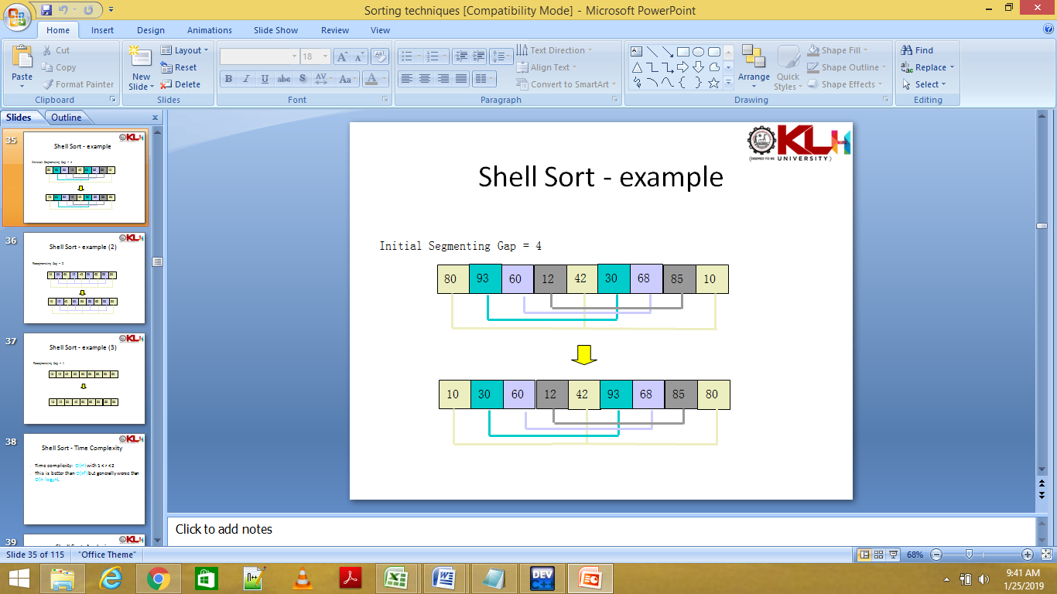
Shell sort Example

Slide 8
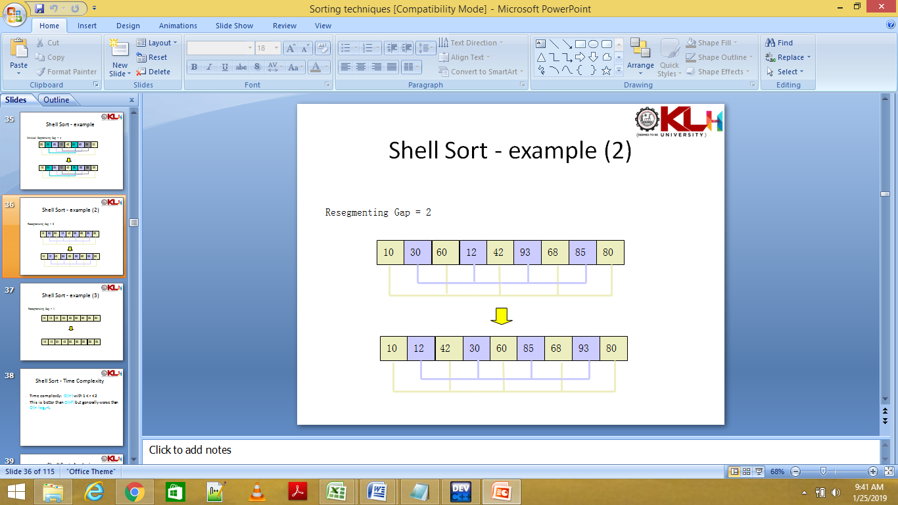
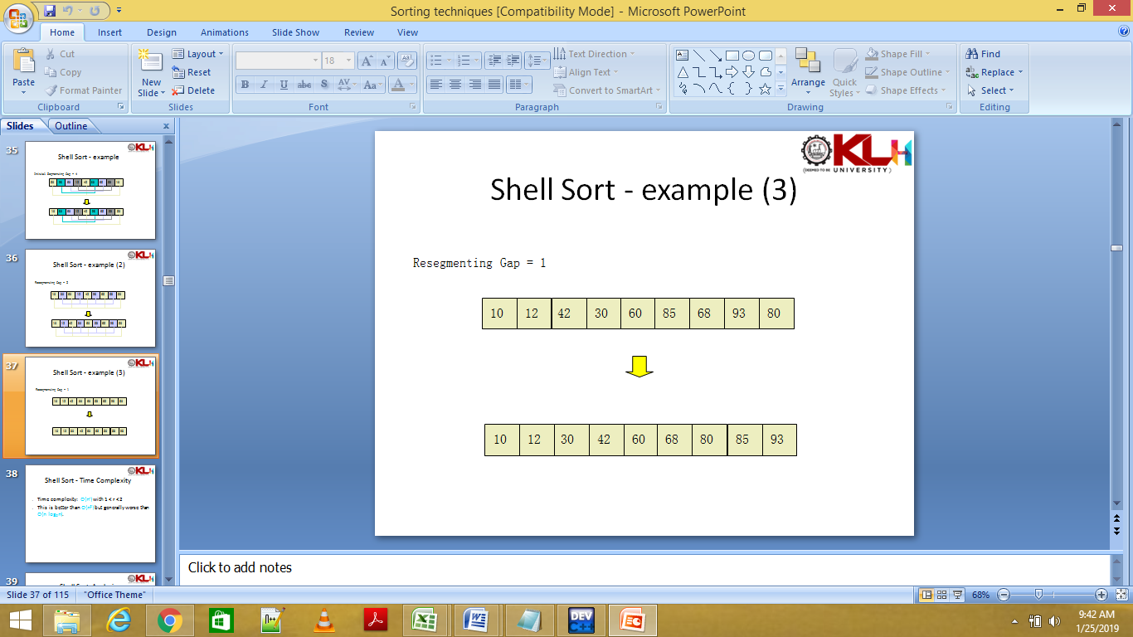

Slide 9
This algorithm works quite efficiently for small and medium size array as its average time complexity is near to O(n).
Time complexity of Shell Sort depends on gap sequence . Its best case time complexity is O(n* logn) and worst case is O(n* log²n).
Time complexity of Shell sort is generally assumed to be near to O(n) and less than O(n²) as determining its time complexity is still an open problem.
The best case in shell sort is when the array is already sorted. The number of comparisons is less.
It is 5 times faster than the bubble sort and a little over twice as fast as the insertion sort.

Slide 10
Advantage
Its relatively simple algorithm makes it a good choice for sorting lists of less than 5000 items unless speed is important.
It's also an excellent choice for repetitive sorting of smaller lists.

Slide 11
Disadvantage
Disadvantage of Shell sort is that, it is a complex algorithm and is not nearly as efficient as the merge, heap and quick sorts.
Since in this algorithm insertion sort is applied in the large interval of elements and then interval reduces in a sequence, therefore the running time of Shell sort is heavily dependent on the gap sequence it uses .

Slide 12
Time Complexities of Shell Sort
The best case ∊ O(nlogn):
The best-case is when the array is already sorted. This would mean that the inner if statement will never be true, making the inner loop a constant time operation. Using the bounds you've used for the other loops gives O(nlogn). The best case of O(n) is reached by using a constant number of increments.
The worst case ∊ O(n^2):
Given your upper bound for each loop you get O((log n)n^2) for the worst-case. But add another variable for the gap size g. The number of compare/exchanges needed in the inner loop is now <= n/g. The number of compare/exchanges of the middle while is <= n^2/g. Add the upper-bound of the number of compare/exchanges for each gap together: n^2 + n^2/2 + n^2/4 + ... <= 2n^2 ∊ O(n^2). This matches the known worst-case complexity for the gaps you've used.

Slide 13
Summary
Worst Case Time complexity: O (n²)
Average Case Time complexity: depends on gap sequence.
Best Case Time complexity: O(n*logn)
Worst Case Space Complexity: O(n) total, O(1) auxiliary
Data Structure: Array
Sorting In Place: Yes
Stable: No

